Slide 1
Software Architecture Process

Slide 2
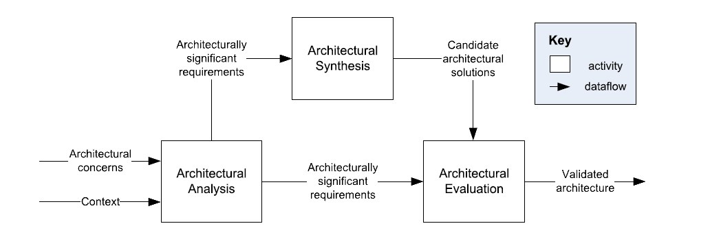
A General Architecture Process Model
C. Hofmeister, et al., A general model of software architecture design derived from five industrial approaches, Journal of Systems and Software, 80:106-126, 2007.

Slide 3
Architectural Analysis
Define the problems the architecture must solve.
Inputs:
Architectural Concerns: Interests which pertain to the system’s development, its operation or any other aspects that are critical to one or more shareholders
Context: The setting and circumstances of developmental, operational, political and other influences upon the system
Output:
Architecturally Significant Requirements: A requirements upon a software system which influences its architecture

Slide 4
Architectural Synthesis
Proposes architectural solutions to a set of Architecturally Significant Requirements
Input:
Architecturally Significant Requirements
Output:
Candidate Architectural Solutions: Design decisions about the structure of the software

Slide 5
Architectural Evaluation
Ensure that the architectural designs decisions made are the right ones
Inputs:
Architecturally Significant Requirements
Candidate Architectural Solutions
Outputs:
Validated Architecture: A subset of candidate architectures that are consistent with the Architecturally Significant Requirements

Slide 6
Repeatable Processes for Software Architecture
Analysis, Synthesis, and Evaluation are the core concepts of many architectural methodologies.
Examples:
  Attribute-Driven Design
  RUP 4+1 Views
  Business Architecture Process and Organization (BAPO/CAFCR)
No one process is best – each has its strengths and weaknesses.

Slide 7
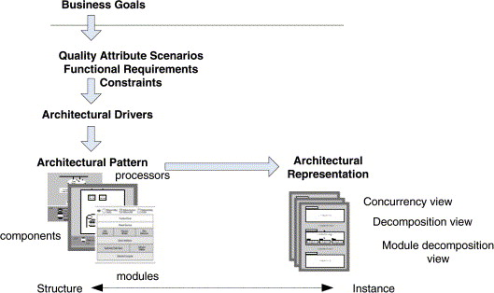
Attribute Driven Design

Slide 8
Design Purpose
Primary Functionality
Quality Attributes
Constraints
Architectural Concerns
Step 1: Review Inputs
Step 2: Establish Iteration Goal
Step 3: Choose Elements to Refine
From previous round of iterations OR from existing system
Step 4: Choose Design Concepts
Iterate if necessary
Step 5: Instantiate Architectural Elements
Step 6: Record Design Decisions
Step 7: Review Design
(Refined) Software Architecture Design

Slide 9
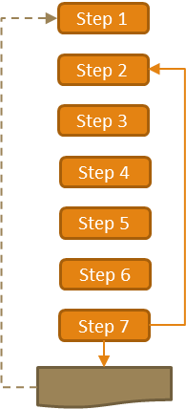
ADD Step 1
Review Inputs: Ensure the architecture drivers are available and correct
  Design Purpose – The goal of this round of Architectural Design
    Evaluate opportunities
    Design the foundation of the system
    Augment the current architecture
  Primary Functionality – Functionality that is critical to achieve the business goals that motivate the development of the system
  Quality Attributes – The subset of QAs this round is focused on
    Derived from ASRs, focus on measurable or testable qualities
  Constraints – Non-negotiable concerns
    Existing systems
  Architectural Concerns – Things that need to be considered as part of the architectural design, often not captured by traditional requirements
    Overall System Structure
    Allocation of modules to teams
    Issues that come from design reviews
Design Purpose
Primary Functionality
Quality Attributes
Constraints
Architectural Concerns

Slide 10
ADD Step 2
Establish Iteration Goal by Selecting Drivers
Waterfall development model consists of one round, therefore the goal is to satisfy all architectural activities
Iterative development (Agile) model consist of multiple rounds; each round should focus on a specific goal
  Round 1 of a Greenfield System in a mature field may be to select the overall Reference Architecture
  Round 1 of a Greenfield System in a new, evolving field may be to develop a prototype architectural model based on the key Drivers
  Round 1 of a Brownfield System may focus on how the existing architecture extends to support the new functionality
  Later rounds may focus on a specific area – Security, Performance, etc. Where the specific area is based on the Drivers

Slide 11
ADD Step 3
Choose One or More Elements of the System to Refine
Satisfying drivers requires making architectural design decisions
Based on the Drivers selected during Step 2, identify the elements that require additional refinement. Potential types of refinement:
  Decomposition
  Composition
  Improve / extend existing elements
  For a Greenfield system the first iteration will start with the system context diagram and refining / defining it
  For Brownfield systems the first iteration may focus on understanding the existing system and the elements you will need to be working with

Slide 12
ADD Step 4
Choose One or More Design Concepts that Satisfy the Selected Drivers
Leverage existing solutions, combine and adapt them as necessary
  Reference Architectures – A model architecture to solve a common problem, for instance a Client-Server model for providing a Web Service or AUTOSAR a reference model for software in automobiles
  Architectural Design Patterns – Conceptual solutions to reoccurring design problems, the Layer pattern is a commonly used example
  Deployment Patterns – How to physically structure a system for deployment, Load Balanced Cluster
  Tactics – Design decisions that influence the control of a quality attribute

Slide 13
ADD Step 5
Instantiate Architectural Elements, Allocate Responsibilities and Define Interfaces
Apply the design concept to the element(s) under consideration
For instance if we’re focused on the enabling user interactions with the system and we’ve chosen the architectural pattern Model-View-Controller
  Where does each component reside?
  What is the model we need to convey to address Usability?
  What parts of the system does the controller need to interact with?
We may not know the answers to all these questions and future iterations may be required to further refine them

Slide 14
ADD Step 6
Sketch Views and Record Design Decisions
Document it
Design decisions have been made, the results are likely diagrams and supporting rationale
Now is the time to capture that information, before its lost

Slide 15
ADD Step 7
Perform Analysis of Current Design and Review Iteration Goal and Achievement of Design Goal
Review the architecture against the drivers and overall system goals
If the drivers are met and the design purpose is satisfied, declare victory and move forward
If there is still work to complete to meet the design purpose, continue on to the next set of drivers
If the drivers are not met, determine what needs to change and revise the architecture

Slide 16
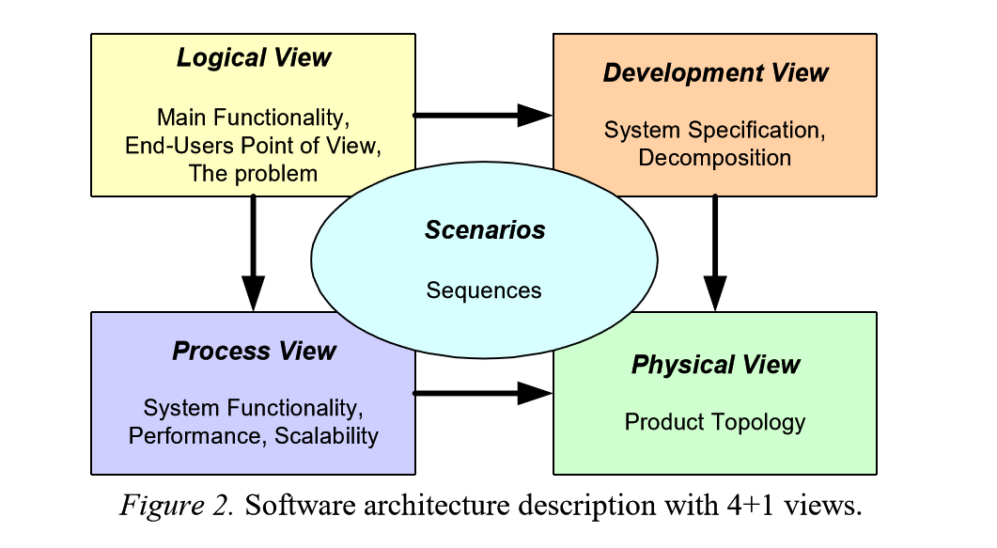
RUP 4+1 View

Slide 17
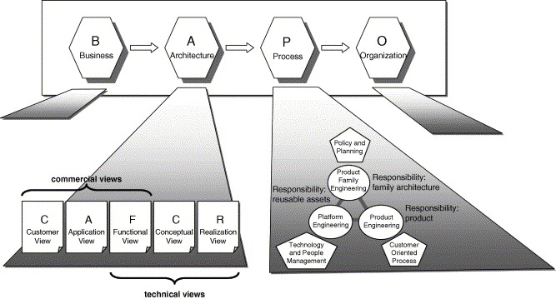
BAPO/ CAFCR

Slide 18
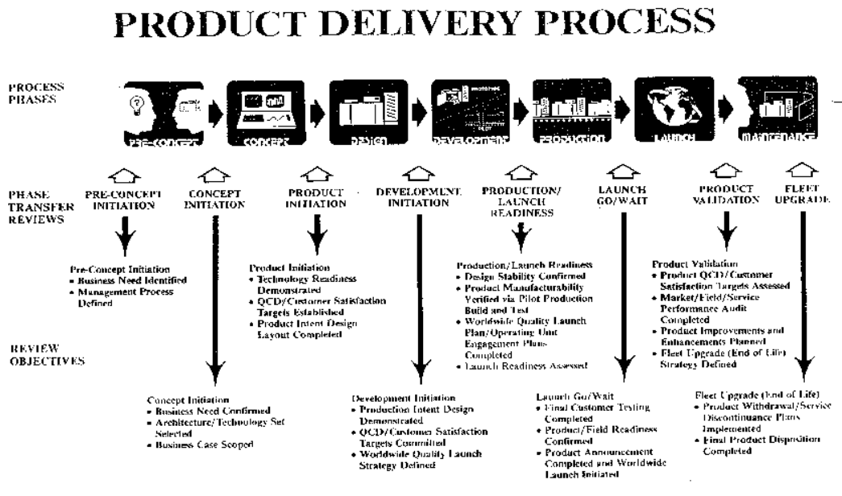
Notes:
Xerox Product Delivery Process, circa 1990s
Software Architecture was a dominant concern in the Concept Initiation and Product Initiation phases. Architecture would be well established by the start of Development.
Note the long lag time between identification of QCDs (Quality Targets) and validation.

Slide 19
Scenarios
Web application for banking
Describe a:
- Performance Attribute
- Security Attribute
- Integrity Attribute
- Availability Attribute
Control system for driverless car
Describe a:
- Performance Attribute
- Security Attribute
- Safety Attribute
- Reliability Attribute
What would be a good example of a Portability Attribute?
Notes:
Portability: Mobile app (iOS/ Android)

Slide 20
Examples
If you are building a desktop application
- Connects to online brokerage system
List some assumptions
List some dependencies
Notes:
Assumption: Have license to connect to brokerage system
Dependency: API documentation is available

